Slide 1
FOLLOW A RIVER
NAME
PARHAM SHHRIVAR

Slide 2
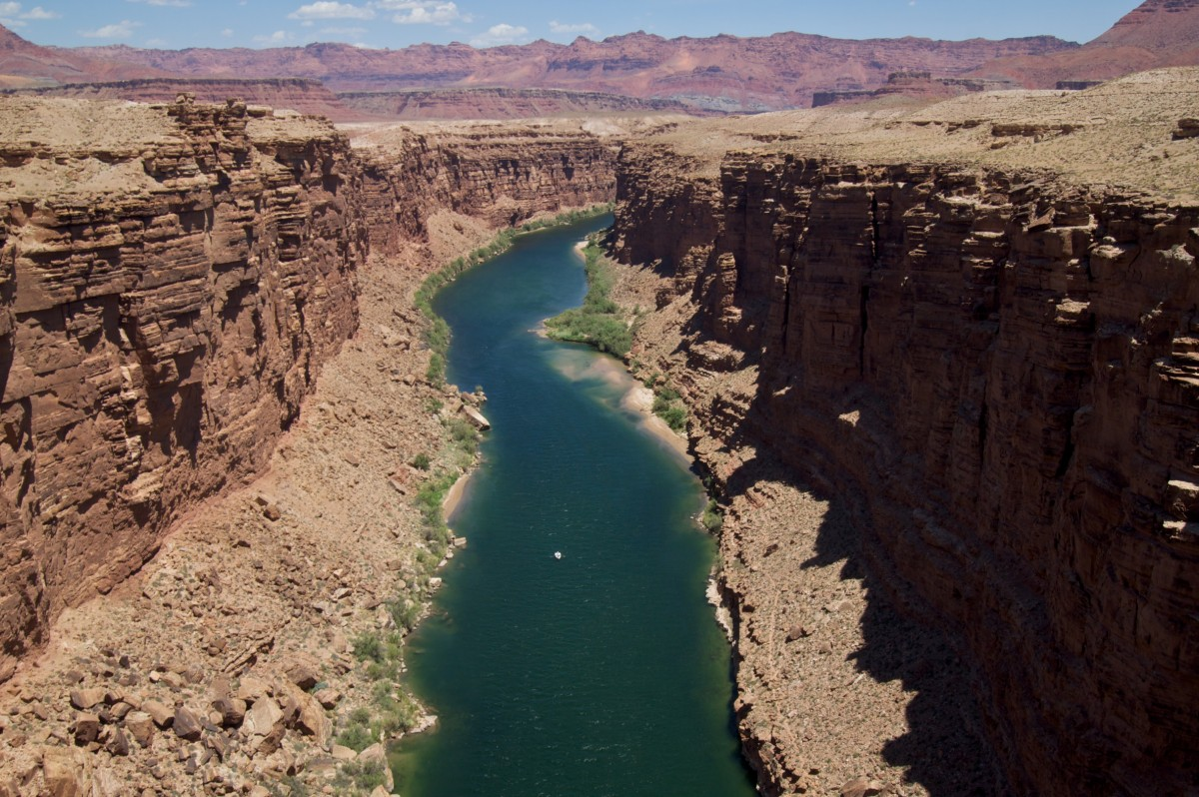
What is a river
A river is a waterway that fiows across land.
Some rivers are clam. They fiow slowly and
Gently across the land. Other rivers flow quickly
Forming water falls and rapids whether a river
Roars or drifts depends the shape of the land
It flows over.
Each river has its own path. It begins at a
Source, such as spring , lake or glacier. Most
Rivers end when theyreach the ocean, or flow
Into another river or lake

Slide 3
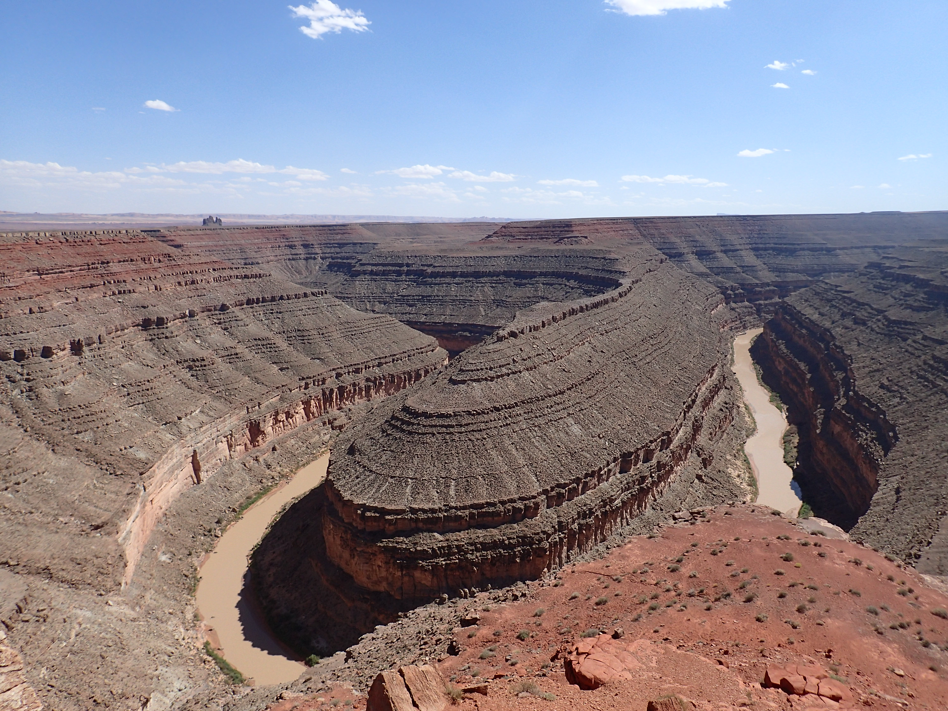
Erosion and sediment
Rivers constantly reshape the landscape.
A famous example is the grand canyon, which was
For med by the Colorado river over 10
million years.

Slide 4
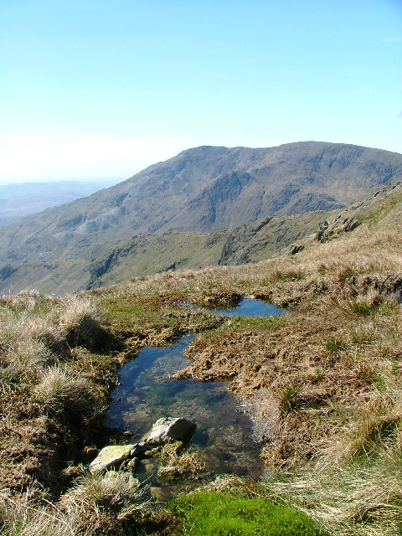
At the source
Formation
Excess water that is not absorbed by the
Ground forms runoff this runoff collects in to
Small streams called rivulets which eventually
Join together to create a river

Slide 5
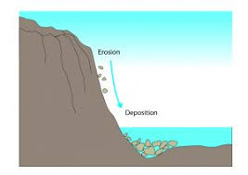
What is deposition
DEFINITION ***While erosion wears land away deposition
Builds it up by placing sediment carried by
The river in a new area
LOCATION***It often occurs on the inner
Bend of rivers of at the mouth of the river where
It forms deltas

Slide 6
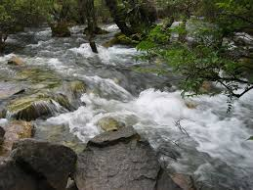
Moving downstream
RIVER SPEED AND LANDSCAPES***
Rivers flow rapidly over steep ground carving
Out the deep narrow valleys. When the ground
Is level they flow more slowly creating wider
Valleys with gentle slopes

Slide 7
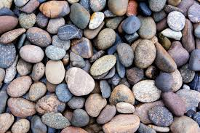
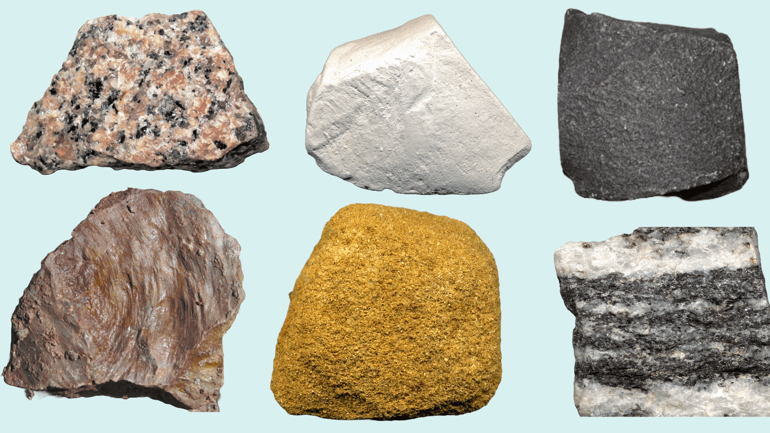
TYPPES OF ROCKS
***
The type of rock affects the river shape.
Hard rock can lead to steep gorges
While a mix of hard and soft rock
Can create rapids as the water
Speeds up over the tougher
section

Slide 8
I HOPE YOU LIKE IT

