Slide 1
Changing Forms of Energy
Name : Roham
Teacher Name : Mr. Jafary

Slide 2


What Is Energy ?

Slide 3
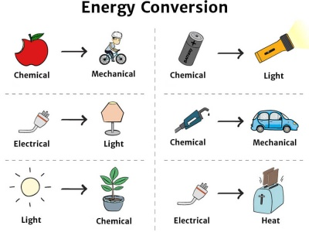
Low of Energy

Slide 4
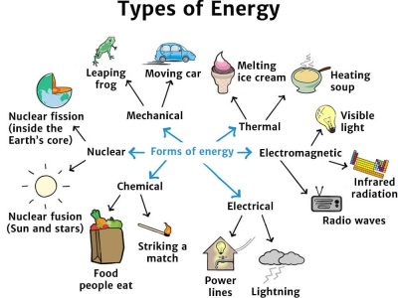
Main Forms of Energy

Slide 5
Kinetic Energy Example : A basketball has more kinetic energy than a beach ball if they move at the same speed.
Kinetic Energy Changes

Slide 6
Potential Energy
Types of Potential Energy

Slide 7
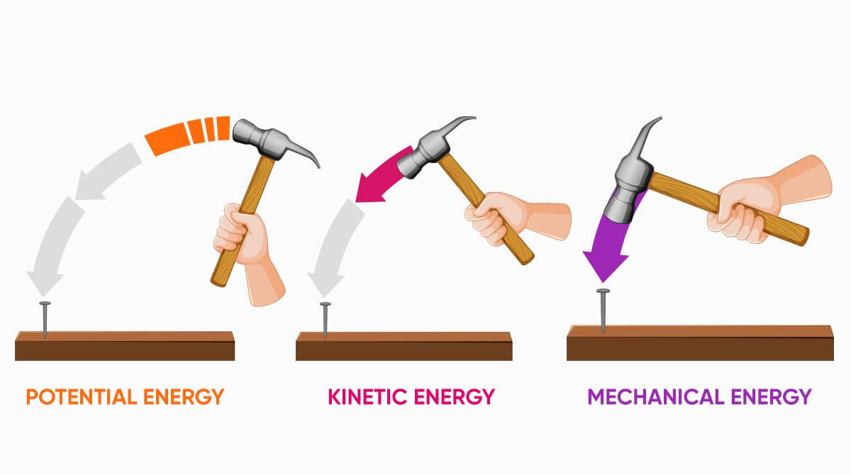

Slide 8
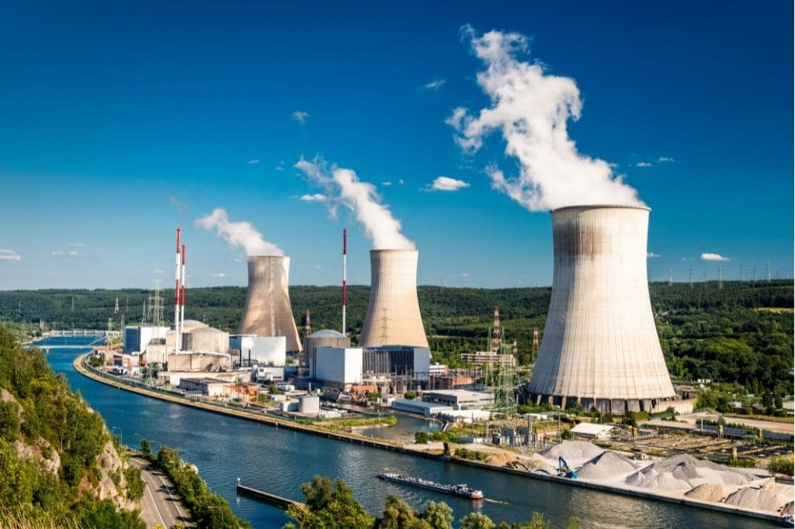
Nuclear Energy

Slide 9

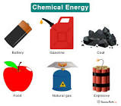
Chemical Energy

Slide 10


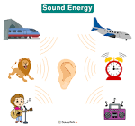

Sound Energy
Behavior of Sound

Slide 11




Light Energy

Slide 12
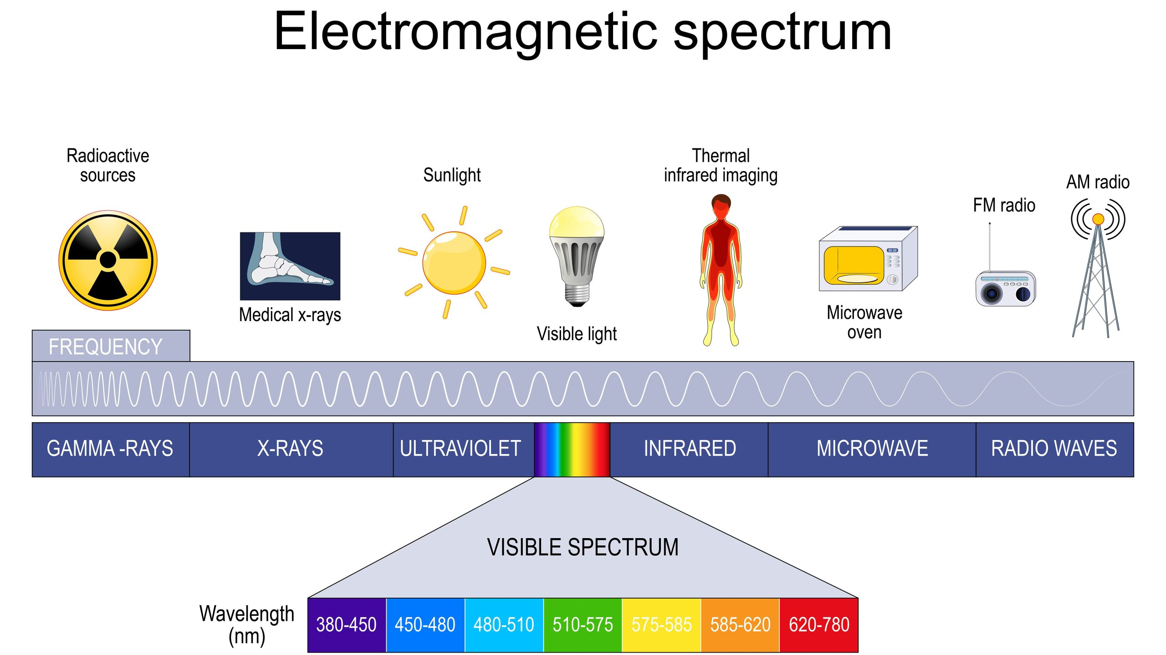
Electromagnetic Spectrum

Slide 13
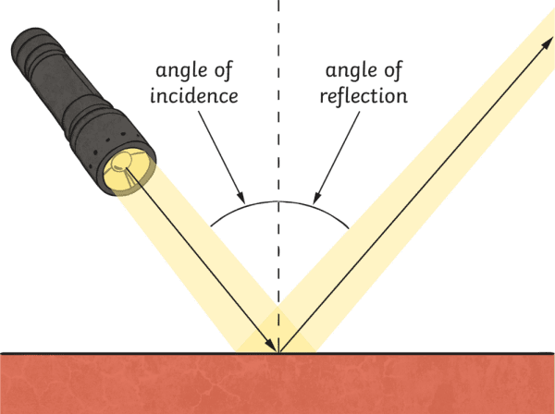
How Light Moves

Slide 14
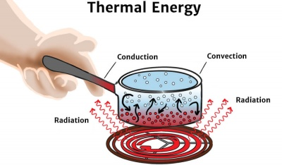
Thermal Energy

Slide 15


Heat Transfer

Slide 16
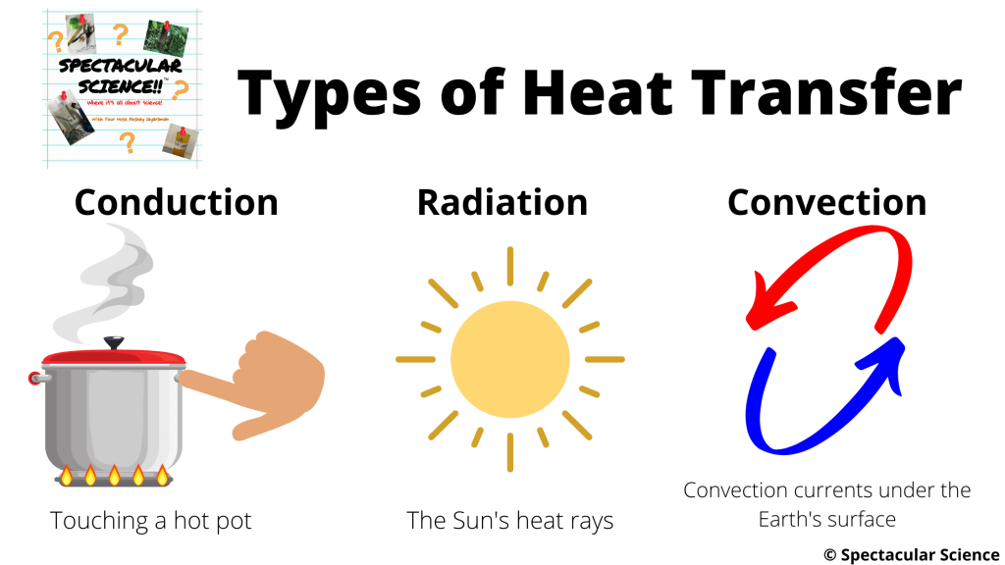
Types of Heat Transfer

