Slide 1
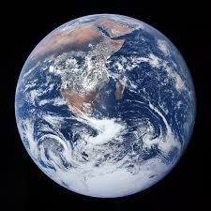

Follow a raindrop:
mehrad bakhtiari
Class:7/3
Mr.Jafari

Slide 2
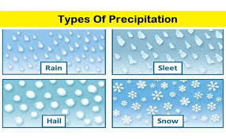
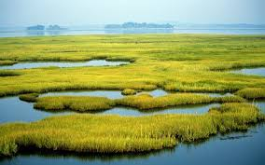
WATER
Water is everywhere and it’s constantaly changing form.
Rain,snow,sleet,and hail are all forms of water.
Most of the fresh water on Earth is frozen as ice.
Wetland:when rivers and lakes over flow or when the ground
Can’t take in anymore water wet lands form.

Slide 3

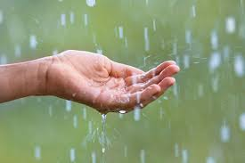
RAIN
Rain is a type of precipitation.it falls from the clouds to Earth’s surface
In the form of liquid droplets.
Heavy rain , can make it unsafe and difficult to travel.

Slide 4
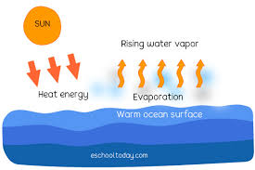
Water cycle
Evaporation:
Is an important part of the water cycle . During the process of evaporation , water
Changes from a liquid state into a gas.

Slide 5
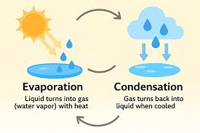
Condensation:
When water vapor cools in the air, it turns into tiny water droplets.
The water has changed it’s form.
From a gas into a liquid. This is a physical change named condensation.

Slide 6
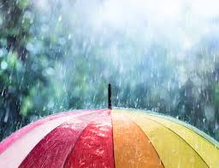
How the rain form?
Remember the water droplets that form clouds?
When enough of them condense into large enough particles,they fall as rain.

Slide 7
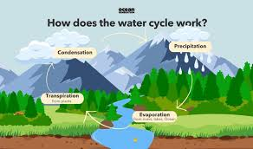
What does the rain do?
Rain feeds Earth’s water systems . those systems include rivers , lakes , streams ,
And oceans.
Water cycle features
The water cycle never stops changing water from one form to
another or moving it From one place to another.

